Slide 1



Sipna College of Engineering & Technology, Amravati.
Department of Computer Science & Engineering
A Presentation
on
Talent Bridge: AI-Integrated Placement Web Application
Presented by
Vedant S. Raut
Ayush R. Raut
Raj S. Vishakarma
Lokesh G. Wagh
Devanshu S. Tambhake
Guided by
Prof. S. N.Sawalkar
2024-2025

Slide 2
CONTENT:-
ABSTRACT
INTRODUCTION
PROBLEM STATEMENT
OBJECTIVE
LITERATURE REVIEW
RESEARCH METHODOLOGY
SYSTEM REQUIREMENT
ADVANTAGES AND APPLICATIONS
IMPLEMENTATION AND RESULT
CONCLUSION AND FUTURE SCOPE
REFERENCES

Slide 3
ABSTRACT
This project presents "Talent Bridge", an AI-integrated placement web application designed to simplify the campus recruitment process.
It connects students, companies, and placement coordinators on a single digital platform.
With AI-powered tools like mock interview simulators, resume analyzers, and aptitude quizzes, it enhances students' job readiness.
The system also includes three mini AI modules:
AI Mock Interview using Gemini API (Next.js)
AI Chatbot using Botpress
AI Resume Analyzer (Streamlit + FastAPI)

Slide 4
INTRODUCTION
Campus placements can be inefficient, unstructured, and limited in reach.
Traditional methods lack customization, automation, and AI-driven feedback.
This project introduces a centralized system to help students prepare and apply for jobs, while enabling companies to recruit efficiently.
Leveraging modern tech stacks like React, Node, AI APIs, and databases ensures a scalable, full-stack solution.

Slide 5
PROBLEM STATEMENT
Traditional placement communication is done through WhatsApp groups and emails.
Important updates often get lost or buried in message threads.
Students miss job opportunities due to outdated or overlooked messages.
There is no proper system to track job applications or student progress.
Students lack access to structured preparation tools (like resume builders and mock interviews).
This leads to an unorganized and inefficient placement experience.

Slide 6

OBJECTIVE
2. Automate resume creation, job applications, and interview preparation.
Build an AI-integrated placement ecosystem.
3. Provide personalized feedback to enhance student employability.
4. Enable admin control and analytics for better management.

Slide 7
LITERATURE REVIEW
Traditional Placement Portals: Platforms like Naukri, Indeed, and college ERP systems only provide basic job posting and application tracking but lack AI-based personalized learning and mock interview simulations.
AI in Interview Preparation: Several studies have explored the use of AI in simulating interviews. Research shows that AI-generated questions and feedback improve student readiness and reduce anxiety before actual interviews.
Resume Evaluation Systems: Existing resume analyzers like ResumAI and JobScan use keyword-matching techniques but lack real-time feedback or integration with personalized job portals.
Chatbot-Based Student Helpdesks: Educational institutions have implemented chatbots for FAQs, but few utilize intent-based conversational flows powered by NLU for career guidance like in Botpress.

Slide 8
LITERATURE REVIEW
Online Skill Assessment Platforms: Websites like HackerRank and Mettl focus on coding and aptitude tests but don’t integrate with placement systems for automatic job recommendations or analytics.
Gap in Integration: Most existing tools work in isolation — one for resume, another for mock interviews, and another for job search. Your project bridges these tools into one unified system.
Use of AI APIs (Gemini/ChatGPT): The latest advancement in Generative AI (e.g., Gemini Flash) allows for context-based interaction and better natural language processing, enhancing both mock interviews and resume scoring in your system.

Slide 9
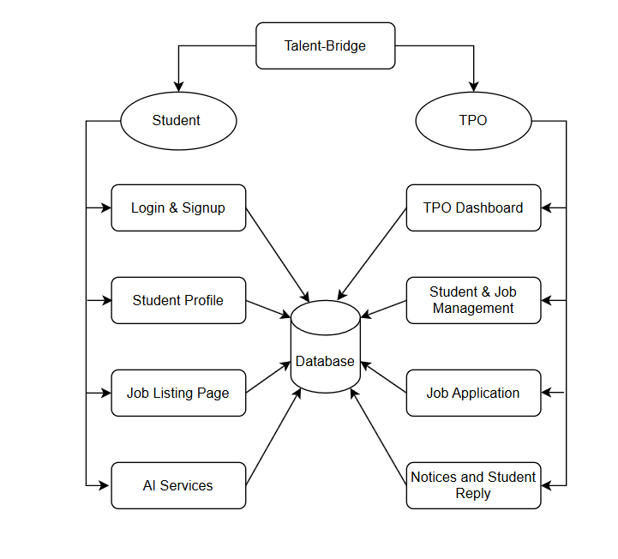
Project Overview

Slide 10
WORKING
User Registration & Login
Students, companies, and admins register and log in securely using JWT-based authentication.
Student Dashboard Access
Students can create profiles, upload resumes, apply for jobs, and access AI tools like mock interviews and resume analyzers.
AI Mock Interview Simulation
Using Gemini API, the system simulates an interview, asks questions based on resume and domain, and gives AI feedback.
Resume Analyzer Module
Students upload resumes which are scanned using PyPDF2 and analyzed by the Gemini API for strengths, weaknesses, and suggestions.

Slide 11
WORKING
Botpress Chatbot Support
An AI chatbot guides users through features, placement tips, and frequently asked questions using natural language understanding.
Admin & Company Panel
Admins can manage users, job listings, and analytics. Companies can post jobs, view applications, and shortlist candidates.
Real-Time Interaction & Job Application
Students apply for jobs in real-time, and all activity is stored and managed through a centralized backend with a user-friendly interface.

Slide 12
SYSTEM REQUIREMENT
Frontend: HTML, CSS , React.js, Next.js
Backend: Node.js, Express, JWT, Multer, Axios, RestAPI
Databases: MySQL, PostgreSQL (Neon)
AI Tools: Gemini API, Botpress
Version Control : Git & GitHub
Software/IDE : VSCODE , Xampp server

Slide 13
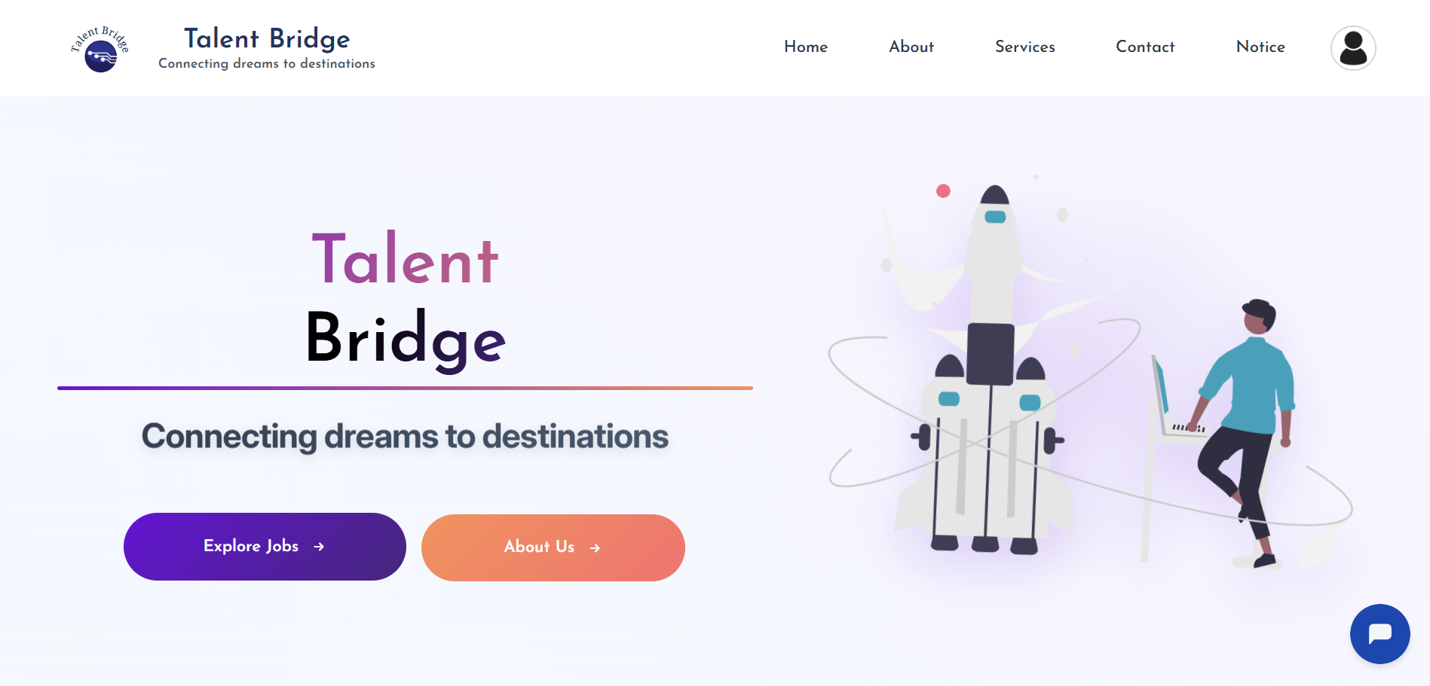
PROJECT MODULE
Student Module
Fig : Landing Page Of Project

Slide 14
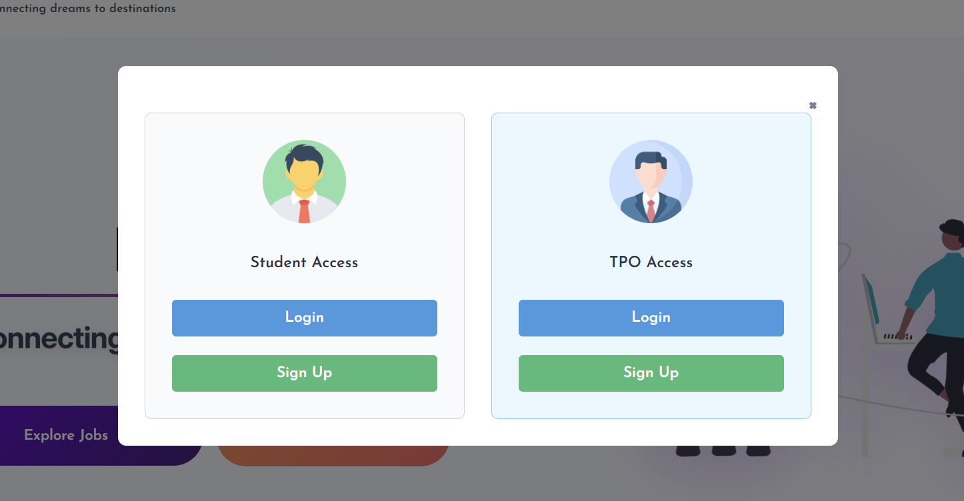
Fig. Shows User Authentication Interface with Student and TPO Access Options

Slide 15
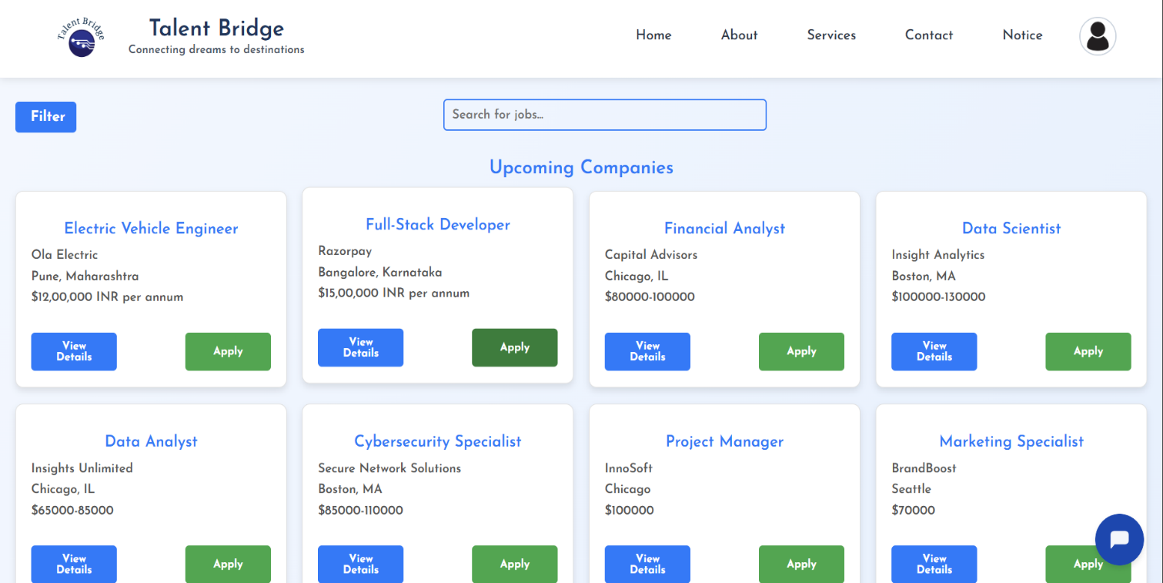
The student dashboard provides access to accurated list of job opportunities from various companies.
Each job card contains key information such as job title, company name, location, and salary range.
Students can click "View Details" to read more about a job or click "Apply" to submit their application.
A search bar and filter options help students easily find jobs that match their skills and interests.
Fig : Job Posting for student

Slide 16
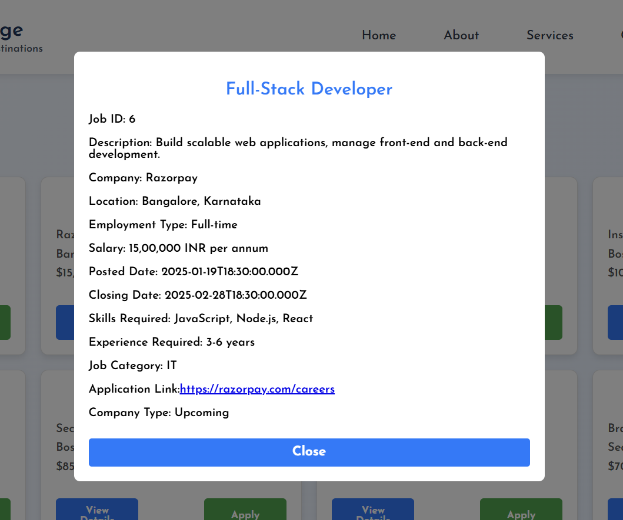
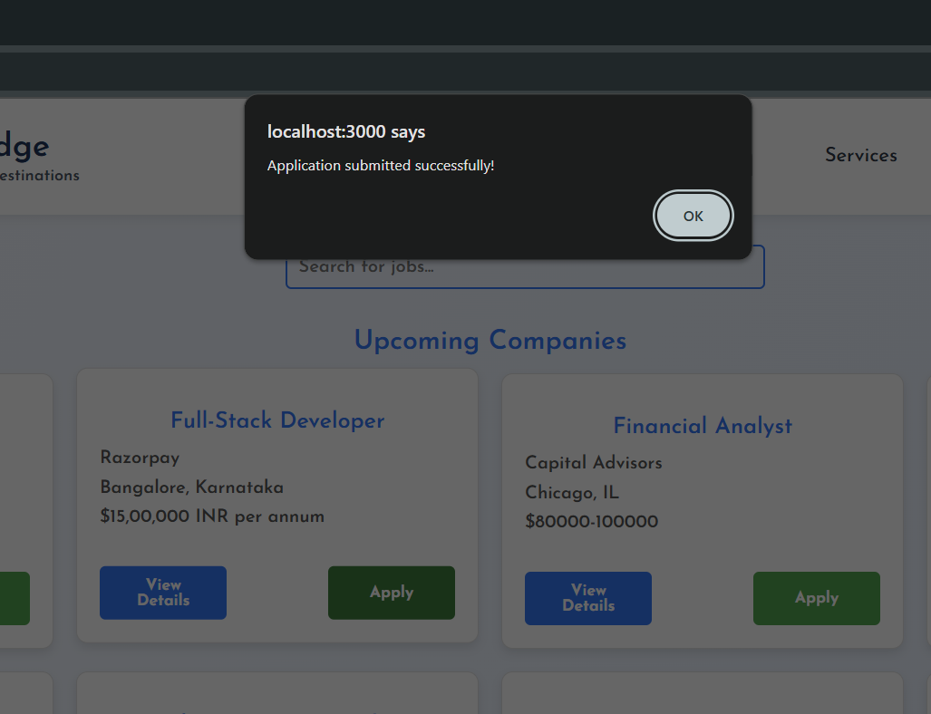
View Button
Apply Button
Fig. View and Apply Button Functionality

Slide 17
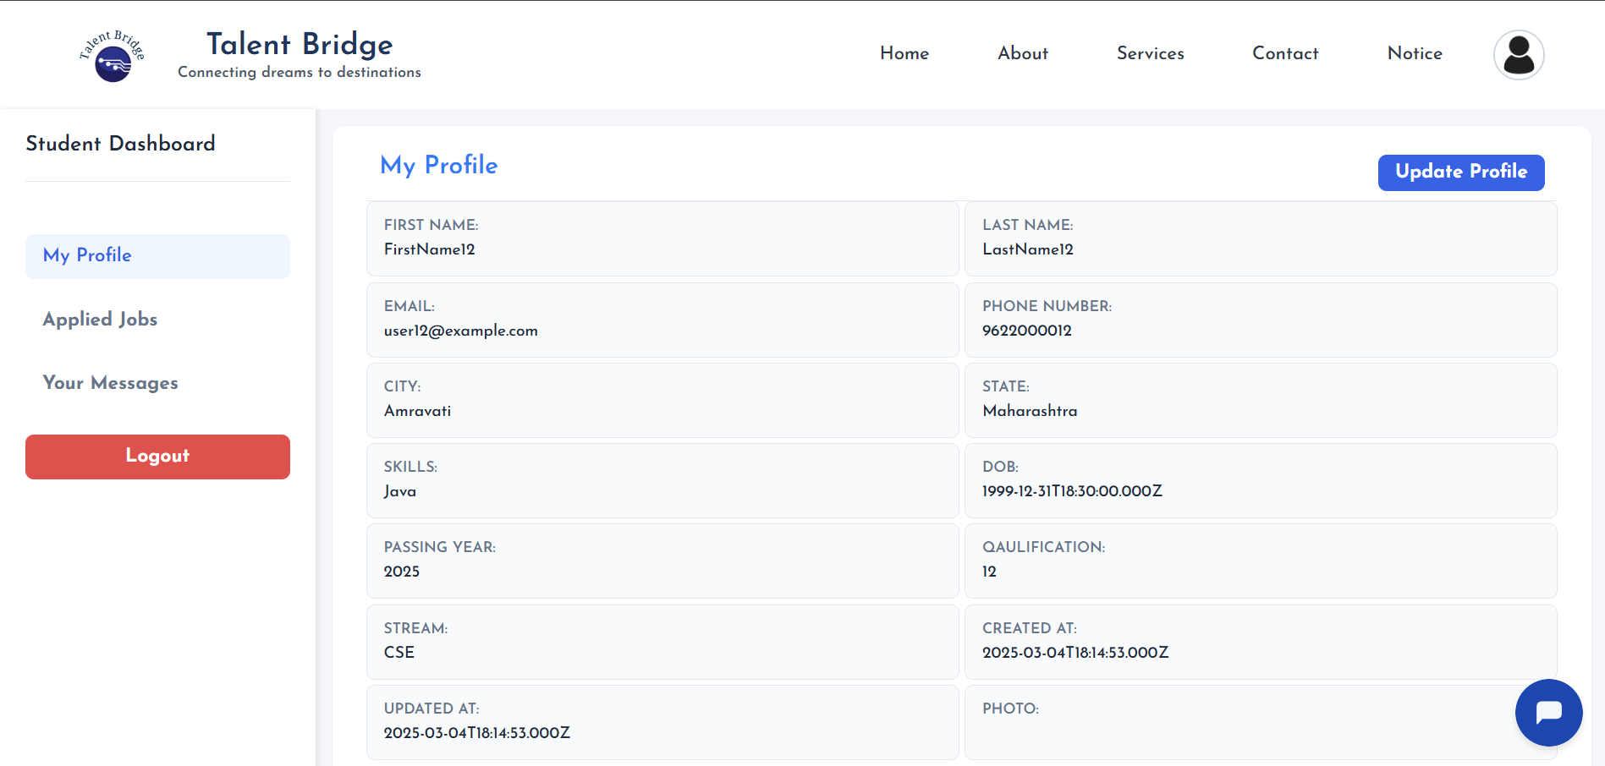
The Student Profile section allows users to view and update their personal and academic information.
Students can update this information as needed using the Update Profile button. This ensures that their data remains accurate and current, which is crucial for applying to jobs and participating in assessments.
Student can see their applied jobs under Applied Jobs section.
Student can contact TPO sir and chat visible in Your Message.
Fig. Student Profile

Slide 18
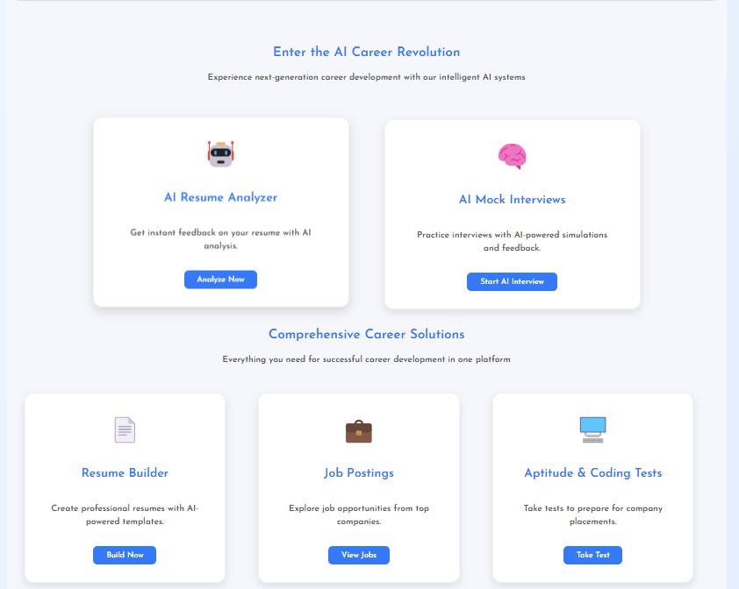
The platform offers various AI-powered and career development tools to support students throughout their placement journey.
Students can analyze their resumes using the AI Resume Analyzer, which provides instant feedback for improvement.
They can also practice interviews through the AI Mock Interviews section with simulated AI interviewers and real-time feedback.
Resume Builder helps students create professional resumes using pre-designed AI templates.
Job Postings allow students to browse and apply for job opportunities from top companies.
Aptitude & Coding Tests help students prepare for placement rounds by taking subject-related tests.
Fig . Services Page

Slide 19
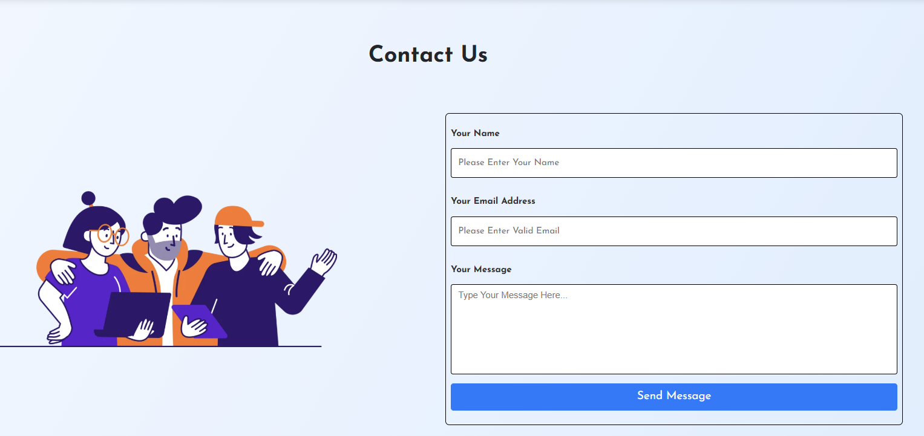
Fig . Contact Us

Slide 20
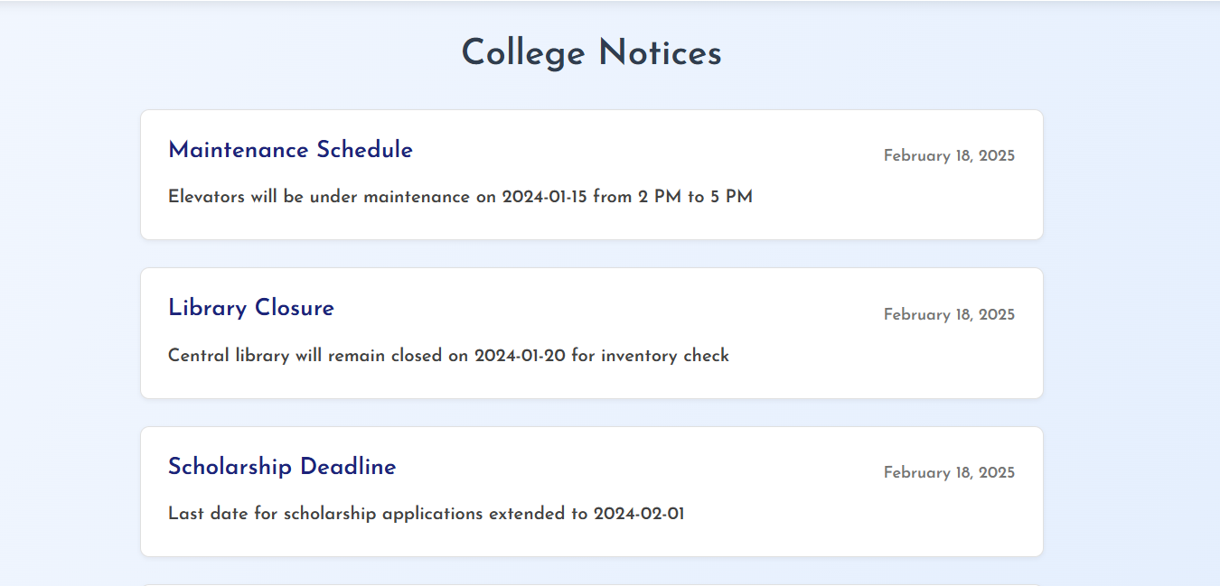
Fig : Notices Page

Slide 21
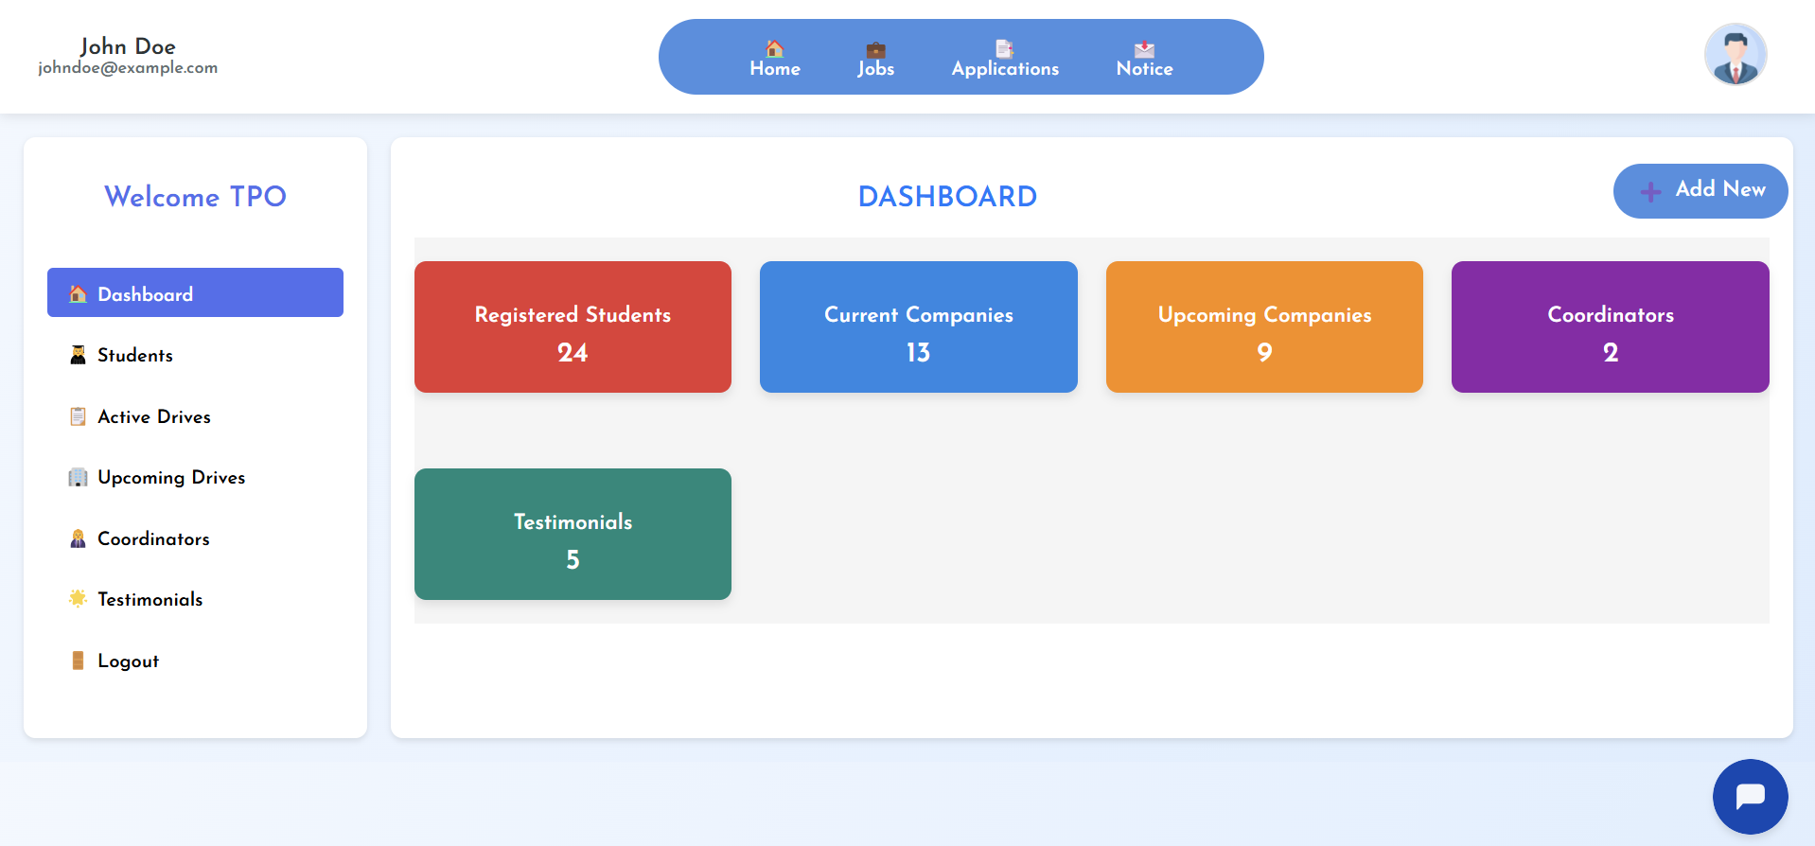
Admin panel
Fig .:Admin Panel

Slide 22
Registered Students View the total number of students registered for the placement platform. Keep track of student participation and manage data easily.
Current Companies Shows the count of companies currently active on the platform. TPOs can coordinate with these companies for placement drives.
Upcoming Companies Displays the number of companies scheduled for upcoming drives. Helps in better planning and communication.
Coordinators TPOs can view and manage campus coordinators who assist in placement activities and communication with students.
Testimonials Displays the feedback and testimonials given by students and companies, which can be reviewed or showcased.
Fig . Admin DashBoard Stats

Slide 23
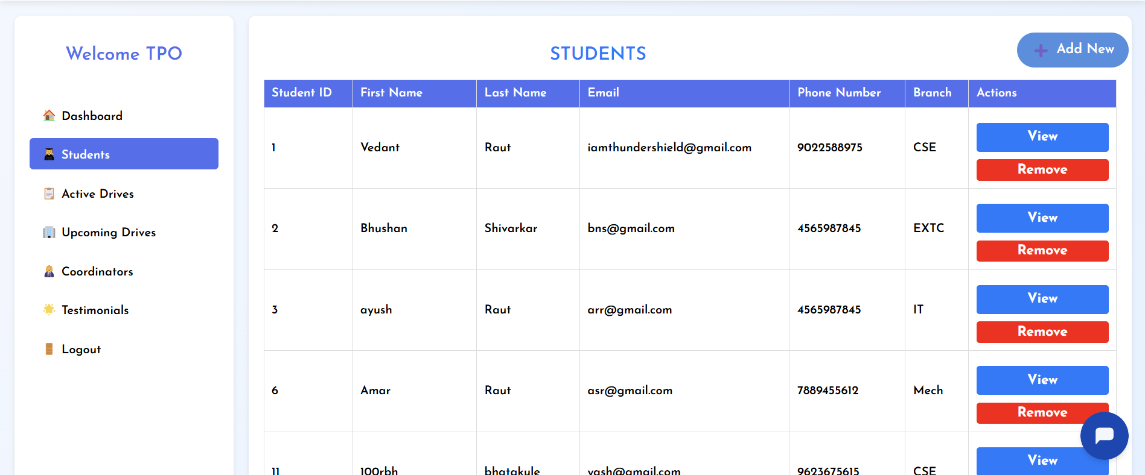
View Student TPOs can view student details like name, email, phone, and branch.
Add Student Click Add New to manually register a student with required info.
Edit Student Student data can be updated via the View option if needed.
Delete Student Use Remove to delete any student record from the system.
Student Table All student info is shown in a simple table for easy tracking and management.
Fig . Student CRUD

Slide 24
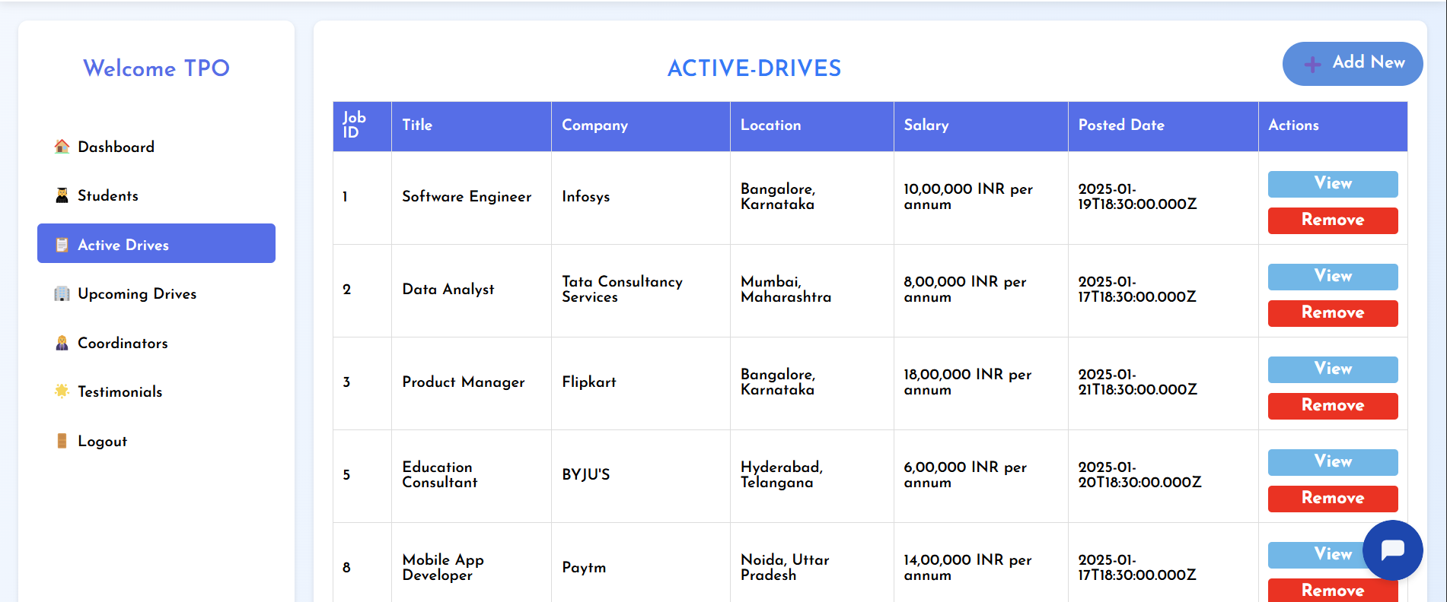
View Job Click View to see full job details like title, company, location, salary, skills, and deadlines.
Add Job Use + Add New to post a new job by entering all required info.
Edit Job Edit option (can be added in View) lets TPOs update job details anytime.
Delete Job Remove button deletes outdated or invalid job posts.
Job Table Jobs are shown in a clean table with columns like ID, Title, Company, and Actions for easy management.
Fig . Jobs CRUD

Slide 25
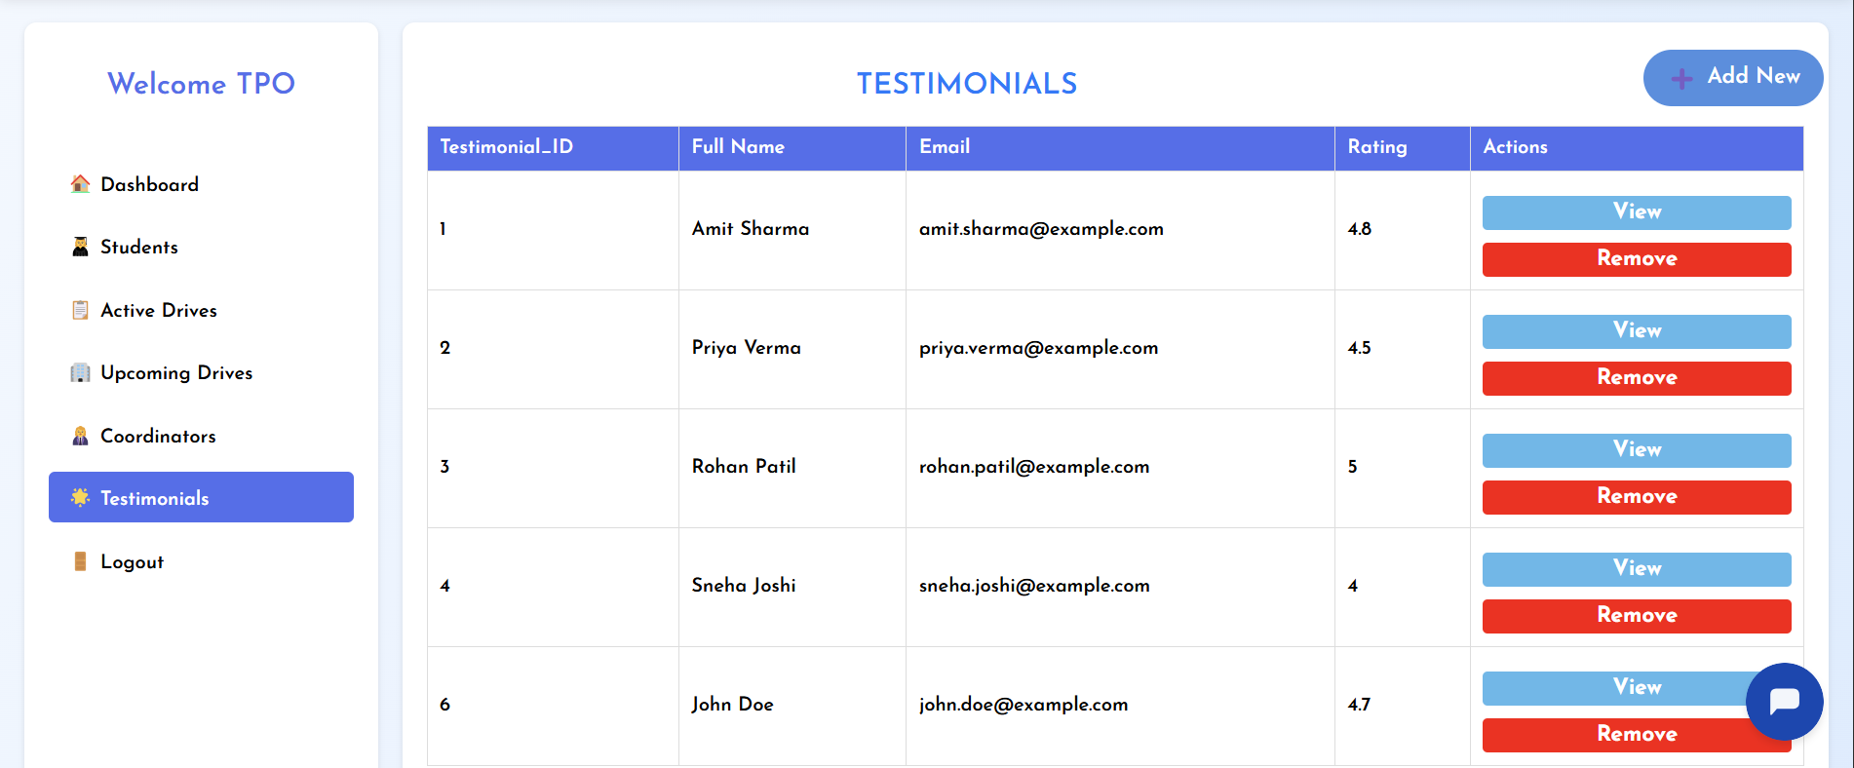
View Testimonial TPOs can click View to read feedback from students or companies.
Add Testimonial Use + Add New to manually add new testimonials with name, role, and message.
Edit Testimonial Testimonials can be updated if needed via the View/Edit option.
Delete Testimonial Click Remove to delete any outdated or inappropriate testimonial.
Testimonial Table All testimonials are listed in a table showing Name, Role, Message, and Actions for quick control.
Fig . Testimonials CRUD

Slide 26
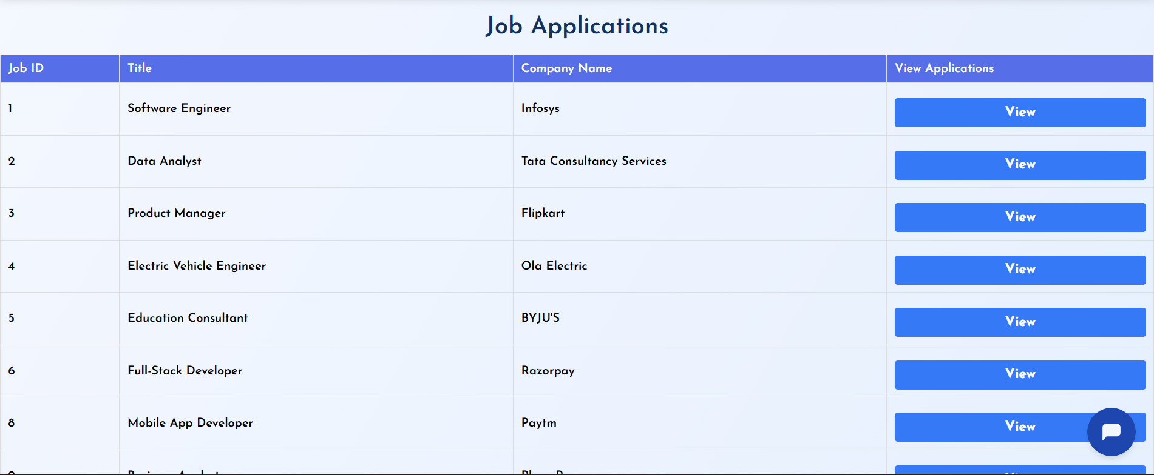
Fig . Job Applications page
Admin can view a list of students who have applied for a specific company.
Each application includes student details like name, email, phone number, and qualification.
This helps TPOs track applicants for each job and share shortlisted candidates with the company.
A clean table format makes it easy to review and manage applications.

Slide 27
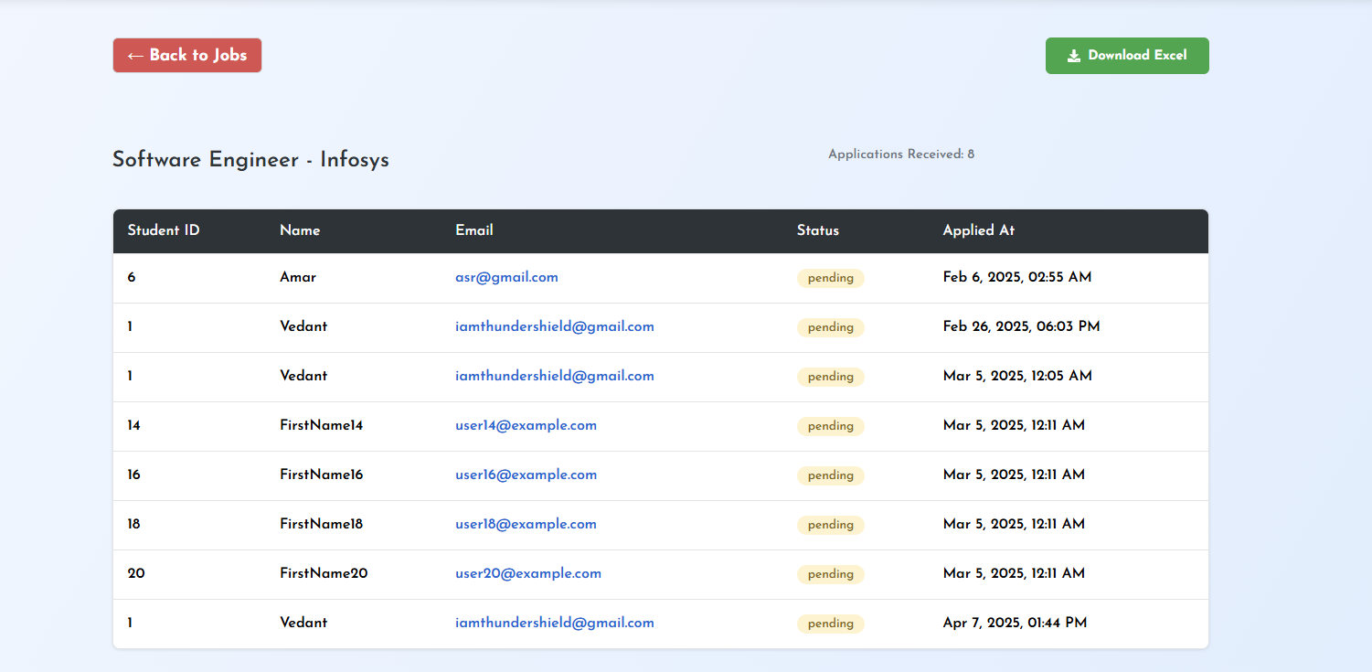
Admin can Download Student List in Excel Format

Slide 28
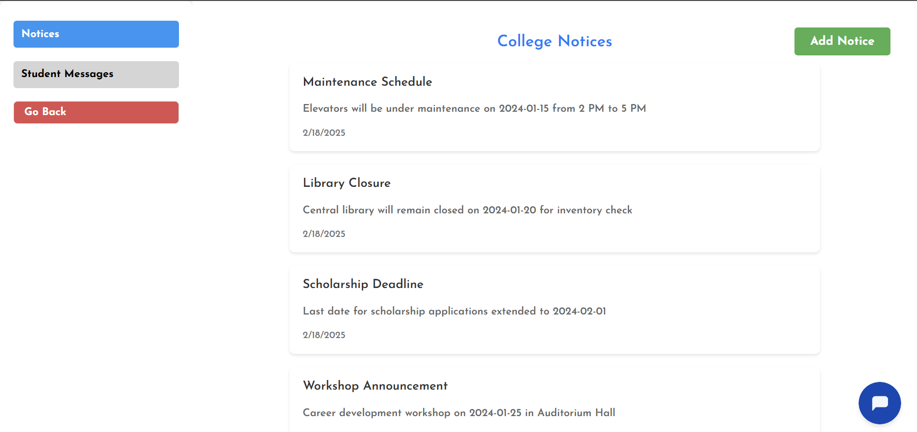
Fig . Admin Notice Section
Admin can post Notices from here.
Admin can able to reply the student Message

Slide 29
CONCLUSION
The Talent-Bridge: AI-Integrated Placement Web Application is a powerful platform designed to bridge the gap between students and recruiters. With features like AI mock interviews, aptitude quizzes, and an easy resume builder, it provides a comprehensive solution for job preparation. The responsive design ensures accessibility across devices, making it user-friendly. However, its reliance on internet access and the potential for downtime are areas for future improvement. Overall, Talent-Bridge holds significant potential for enhancing the placement process and empowering students in their career journeys.

Slide 30
ADVANTAGES
AI Mock Interviews: Students can practice interviews anytime to improve their skills.
Aptitude & Reasoning Quiz: Helps students prepare for placement tests.
Mobile-Friendly Design: The website works well on phones, tablets, and computers.
Easy Resume Builder: Students can quickly create and update their resumes.
DISADVANTAGES
Internet Dependency: Requires a stable internet connection, limiting access for users in low-connectivity areas.
Potential Downtime: Technical issues or server failures can make the website temporarily unavailable.
Non-Tech-Savvy Users: Some students may struggle with advanced features or navigation, limiting accessibility.

Slide 31
APPLICATIONS
Personalized Learning: Students get AI-based insights on resumes/interviews.
Streamlined Process: Companies can manage job postings and applications centrally.
Improved Placement Rates: Data-driven insights improve match between candidates and jobs.
Scalability: Can be deployed across colleges, bootcamps, and even online platforms.
Real-Time Feedback: Students receive instant feedback on resumes and mock interviews to improve continuously.
Recruiter-Friendly Interface: Recruiters can easily filter, sort, and select candidates using AI- based analytics.
Wide Application Scope: Can be integrated into career counseling centers, job fairs, and virtual recruitment drives.

Slide 32
FUTURE SCOPE
AI-Driven Recommendations: Integrate AI to provide smarter, real-time suggestions for learning resources, career paths, and skill development.
Peer Learning & Collaboration: Enable forums or discussion boards where students can collaborate, share knowledge, and solve problems together.
Gamified Assessments: Add game-like elements such as badges, leaderboards, and rewards to make learning and assessments more engaging and motivating.
Mobile Application: Develop a mobile app version for enhanced accessibility and learning on the go.
Integration with External Platforms: Allow seamless integration with job portals, LinkedIn, or learning platforms like Coursera/Udemy for better placement opportunities and upskilling.

Slide 33
REFERENCES
[1] Raut, V. S., & Others. (2024). Talent Bridge: AI Integrated Placement Portal. International Journal for Innovative Research in Technology (IJIRT), Vol. 10, Issue 11.
[2] Baile, A., Sawarkar, P., Wankhede, P., Manwatkar, R., Barsagade, R., & Karmore, P. (2021). Implementation of Training and Placement System. International Journal of Scientific Research in Science and Technology.
[3] Choudhary, S., Landge, M., Salunke, S., Sutar, S., & Mhamunkar, K. (2016). Advance Training and Placement web portal. International Journal of Technical Research and Application.
[4] Fakoya, J. T., Ibiyomi, M. A., & Abiona, A. A. (2021). Students’ Final Year Projects Record Management System. International Conference of Sciences, Engineering Technology.
[5] Gupta, S., Hinorani, J., Singh, S., & Phadnis, N. (2021). Designing of Web Portal for Training and Placement Cell. International Research Journal of Engineering and Technology.

Slide 34
THANK YOU !

